Slide 2
Keeping Children Safe in Education 2019/2020
Part 1: Safeguarding information for all staff - updated
Part 2: The management of safeguarding - updated
Part 3: Safer recruitment - No change
Part 4: Allegations of abuse made against teachers and other staff including supply teachers and volunteers - updated
Part 5: Child on child sexual violence and sexual harassment - No change
Notes:
Part 4 now outlines that this is 'anyone working in a school or college including supply staff and volunteers' for clarity this applies to all 'working' in school even if not employed by the school.

Slide 3
Keeping Children Safe in Education 2020
Annexes A-C: Updated Annexes D-G: No change
Annex A: Further safeguarding information
Annex B: Role of the designated safeguarding lead
Annex C: Online safety
Annex D: Boarding schools, residential special schools, residential colleges and children’s homes
Annex E: Host families-homestay during exchange visits
Annex F: Statutory guidance-Regulated activity (children) – Supervision of activity with children which is regulated activity when unsupervised
Annex G: Disclosure and Barring service checks
Annex H: Table of substantive changes from previous versions

Slide 4
Keeping Children Safe in Education 2020
Consultation March 2020 withdrawn due to Coronavirus
Draft March 2020 much more detailed than Sept 2020 version
Likely to result in a 2021 version
Draft until 1st September. Minor changes on 1st Sept include:
Summary: Covid-19 guidance removed/Sexual Violence and Sexual Harassment Between Children in Schools guidance link added
Statutory RSE: Now referred to in present tense throughout document
Cyber bullying: Link removed from Annex A. Unknown why, still included on DfE bullying page
Notes:
Recognising the pressures caused by the pandemic, the Government significantly reduced the changes planned in the draft KCSiE 2020, taking out changes wherever possible.

Slide 5
Why do we all need to know this?
Always been everyone’s business to know about safeguarding but there is likely to be surge because of the lockdown situation
The full picture is not yet known but we do know that during the pandemic,
32% increase in calls to NSPCC from adults concerned about children.
Overall, crime dropped during lockdown but certain types of crime have increased, e.g. online fraud, online child sexual abuse and Domestic Abuse.
The National DA Helpline reported a 120% increase in calls to the helpline and online services since the lockdown conditions were imposed.
The Respect phoneline for people concerned about their own behaviour has seen an increase of about 25%.
Physical abuse cases have risen nationally for 11-18-year old's.
North Tyneside Child Protection plans have risen approximately 20% during this time.
And all this just as schools and support services re-open!
Notes:
To help this spike: Additional staffing in MASH and promotion of the MASH professional helpline.
Social distancing, self-isolating and quarantine can cause stress and changes in everyone's behaviour. Families are under new pressures and for some, this can result in harmful behaviours. Because of all these things, there is likely to be a spike in concerns and referrals as lockdown eases and pupils return to school.
Concerns may be new or of increasing frequency e.g. physical abuse
Different types of abuse e.g. online abuse, gang culture/county lines
Families have been restricted to an unsafe place with no support
What the issues are likely to be…
Domestic Abuse: Initial decrease in DA calls and Operation Encompass notifications but now services seeing a significant increase in DA cases. This is due to lockdown meaning less contact with people so less concerns witnessed/reported. The increase is happening as we come out of lockdown and victims having more contact, are being seen by people and feel safer to make contact with professionals.
Conflict, stress and family tension – caused through families spending more time with another can cause arguments, frustrations, possibly lead to physical abuse or Adolescent to Parent Violent Abuse (APVA).
Online – vulnerability of children due to an increase of accessing online programmes and social media, possible less adult supervision due to parents working or not aware of dangers to children or monitoring what children, young people may be accessing could result in them becoming a potential target.
Substance abuse-Over use of alcohol/drugs as a coping mechanism by parents
Mental health issues increased-both parents and child/ren
Disabled children and young people are just over 3 times more likely to be abused or
neglected than non-disabled young people. And while they may be less visible to professionals and unable to communicate with you easily online or at all, it's important to make a greater effort to keep in touch.
Physical abuse-Bruises and marks less likely to be seen by professionals at this time.
Neglect – impact on families due to decreased incomes or living in financial poverty, food demand increase on families, could be a concern for neglect, safeguarding.

Slide 6
Recognising and responding
MASH professional helpline: 0191 643 5555/0758 303 6798
Escalation and Effective Challenge Policy https://www.northtynesidescp.org.uk/escalation-and-professional-disagreement/
https://www.traumainformedschools.co.uk/images/Recognising_and_responding_to_Anxiety-4.pdf
Notes:
An organisation called Trauma Informed Schools UK have developed a poster to help school staff recognise behaviours in children that are masking feelings that may have come from experiences in lockdown. The poster also outlines best responses to these behaviours. They are a good reminder to staff that behaviour is a response to emotions so hopefully they can try to understand and ee the bigger picture.

Slide 7
Interim updates?
Rationale on the changes
Legislation e.g. RSE and Heath Education
Additional, helpful information and new issues added e.g. mental health, criminal exploitation
Clarifications to text to ensure understanding
Safeguarding definition now includes ‘Preventing impairment of children’s mental and physical health or development’.
Notes:
The safeguarding definition has not been amended in Working Together
Rationale added to outline three main types of changes made to the document. This includes,
Legislation e.g. RSE and Heath Education, updated guidance on upskirting etc.
Additional, helpful information and new issues added e.g. mental health, criminal exploitation
Clarifications to text to ensure understanding
Having a rational explained what had to be included at this point and what could be left until subsequent version to try not to overwhelm schools at this point.

Slide 8
Reminders…
North Tyneside Safeguarding Children Partnership (NTSCP) now fully in place: Local safeguarding children Boards have now been replaces with multi-agency safeguarding arrangements. Locally this is the NTSCP.
Schools should hold more than one emergency contact number for pupils: Link updated to outline this is from the 2006 Education pupil registration regulations.
Transferring Child Protection files: This also applies to in-year transfers.

Slide 9
Reminders…
Information Sharing and Data Protection-Information added for clarity
Information can be shared to enhance the safeguarding of a child
Data protection principles include withholding information as well as sharing. Both can be equally important in safeguarding. More information included on when to withhold information.
Links added to explain the DBS harm test and Data Protection toolkit
Notes:
Information can be shared to enhance the safeguarding of a child-this clarifies things rather than ‘information can be shared when it is a child protection matter’ as sometimes you don’t know it is until you share wider e.g. with the Front Door.
Withholding information is needed e.g. if a child is in emergency accommodation.
The harm test was included before but not explained. To satisfy the harm test there needs to be credible evidence of a risk of harm to children or vulnerable adults such as statements made by an individual regarding conduct/behaviour, etc. For a case to be considered as a risk of harm, relevant conduct would not have occurred (and therefore cannot be charged) but there must be tangible evidence rather than a “feeling” that a person represents a risk to children and / or vulnerable adults. For example, a teacher who confides in their head teacher that they are sexually attracted to children (but who had not engaged in ‘relevant conduct’) would satisfy the harm test.

Slide 10
Main changes
More in-depth regarding mental health issues
Updates to types of exploitation
Changes to managing allegations against staff
Updates to online safety
Links to upcoming statutory RSE and Health Education
Child in Need review and update to links with DSL role
Other updates to specific safeguarding issues
Notes:
In addition to the reminders/small updates, the main changes are,

Slide 11
Types of exploitation

Slide 12
Child criminal exploitation & Child sexual exploitation
All staff should be aware safeguarding incidents/ behaviours can occur outside school or be associated with outside factors often referred to as ‘Contextual Safeguarding’.
CSE and CCE are forms of abuse and both occur where an individual or group takes advantage of an imbalance in power to coerce, manipulate or deceive a child into sexual or criminal activity.
Missing education can also be a sign of CSE, CCE, including involvement in County Lines
Triennial analysis of serious case reviews link added to KCSE highlights the growing statistics linked to serious harm and death of young people from all types of exploitation.
Notes:
Heightened focus on child exploitation and emphasis that child sexual exploitation is seen as part of this.
Emphasise that your safeguarding responsibilities do not stop at the school gates.
New link to guidance in Annex A.
Young people are at risk if they become caught in county lines networks. To reduce the risk to themselves the dealers will use people they think others will not suspect, so any young person on the periphery of drug use or drug taking, or otherwise coming into contact, is vulnerable.
Sometimes gangs form a secure base in the home of a vulnerable person, forcing assistance through violence or exploiting a drug dependency. Leaders or dealers can enter into relationships with vulnerable young females, which can also lead to sexual exploitation or domestic violence. Young people can have drugs or money stolen and become indebted, needing to continue to supply to pay the money back
Often called contextual safeguarding, more specific and updated terms used in new document. Includes risk from extra familial harm such as exploitation and serious youth violence, gang culture, forced into other criminal activity, forced labour, weapons etc although all do often interlink.
Triennial analysis of serious case reviews link added to KCSE highlights the growing statistics linked to serious harm and death of young people from all types of exploitation. This is due to higher levels of violence involved but also suicide.

Slide 13
Allegations against staff

Slide 14
Supply staff
Managing allegations against staff now includes supply staff.
Previous inconsistent practice as school not the ‘employer’.
Now clear that the school retains the lead responsibility as they were “working under supervision, control and direction” of governors/proprietor.
Schools must have a clear process and advise agency of these.
North Tyneside School’s HR have always advocated following up allegations against supply staff.
Notes:
Allegations about members of staff now includes ‘supply staff’ for clarity that allegation management, safer working practices and whistle blowing procedures apply to all adults ‘working’ in school even when school is not the employer. Its has always also included contractors, governors, students and volunteers.
NT have always advocated this but now it is clear in KCSE that in no circumstances should a school or college decide to cease to use a supply teacher due to safeguarding concerns, without finding out the facts and liaising with the local authority designated officer (LADO) to determine a suitable outcome.
The school or college will usually take the lead because agencies do not have direct access to children or other school staff, so they will not be able to collect the facts when an allegation is made, nor do they have all the relevant information required by the LADO as part of the referral process.
When using an agency, schools and colleges should inform the agency of its process for managing allegations.

Slide 15
Amended LADO criteria
behaved in a way that has harmed a child, or may have harmed a child;
possibly committed a criminal offence against or related to a child;
behaved towards a child or children in a way that indicates he or she may pose a risk of harm to children; or
behaved or may have behaved in a way that indicates they may not be suitable to work with children.
Notes:
Also linked to allegations against staff, LADO criteria updated. Explain transferable risk
Previous reliance on someone to make an ‘allegation’, especially children and families
Professionals who abuse children tend to display behaviour that’s of increasing concern in other areas (Misconduct panel e.g. outside of school, substance abuse, theft, violence)
Early identification, prompt & appropriate management, positive & open culture
Transferrable risk: Incident outside of school which did not involve children but could impact on their suitability to work with children. All other points include children being involved.

Slide 16
Online Safety

Slide 17
More focus and enhanced guidance on online Safety
Training: Where safeguarding training is mentioned, the document also adds ‘including online safety’.
Effective online safety arrangements: The governing board must assure themselves of effective arrangements-links to self review tools and resources added.
Education at home: Links added to support where children are being asked to learn online at home.
Annex C of KCSE: Online safety is featured throughout KCSE but Annex C is specifically on Online Safety

Slide 18
Online Safety-Annex C
Additional advice added in specific categories in Annex C
Advice for governors and senior leaders
Remote education, virtual lessons and live streaming
Support for children
Parental support

Slide 19
Notes:
There are lots of additional links to online safety advice and guidance in KCSE 2020 but these are the first few mentioned in the main body of the document. All should read Annex C of KCSE: Online Safety
Teaching online safety in school: .Outlines how schools can ensure their pupils understand how to stay safe and behave online as part of existing curriculum requirements. It complements existing and forthcoming subjects including Relationships Education, Relationships and Sex Education, Health Education, Citizenship and Computing. It does not imply additional content or teaching requirements
Thinkuknow is the education programme from NCA-CEOP, a UK organisation which protects children both online and offline.
Explore one of the six Thinkuknow websites for advice about staying safe when you're on a phone, tablet or computer.
Education in a connected world: A framework to equip children and young people for digital life: Aims of the Framework Education for a Connected World is a tool for anyone who works with children and young people. It enables the development of teaching and learning as well as guidance to support children and young people to live knowledgeably, responsibly and safely in a digital world. It focuses specifically on eight different aspects of online education: 1. Self-image and Identity 2. Online relationships 3. Online reputation 4. Online bullying 5. Managing online information 6. Health, wellbeing and lifestyle 7. Privacy and security 8. Copyright and ownership

Slide 20
Mental Health
Notes:
Mental Health has been given al lot of prominence in KCSE 2020. It represents a move towards a deeper understanding of safeguarding work – not simply ‘seeing the signs of abuse or neglect’, but anticipating the potential for abuse, responding effectively, remedial interventions and recognition of https://safeguarding.network/kcsie confidence in safeguarding the longer term safety and wellbeing implications of abuse & neglect. This is a significant shift and, alongside working with children who have social workers, may have a resource implication.

Slide 21
Mental health
All staff should be aware that mental health problems can, in some cases, be an indicator that a child has suffered or is at risk of suffering abuse, neglect or exploitation.
Where children have suffered abuse and neglect, or other potentially traumatic adverse childhood experiences, this can have a lasting impact throughout childhood, adolescence and into adulthood.
It is key that staff are aware of how these children’s experiences, can impact on their mental health, behaviour and education.
Notes:
Information for all staff-part 1
Subheading and paragraphs added on mental health. Includes information on mental health as a potential indicator of abuse, school support and professional diagnosis, ACEs and long-lasting impact of trauma, mental health as a safeguarding concern and further mental health advice and guidance from DfE and Public Health England.

Slide 22
Mental health
Staff are well placed to observe children day-to-day and identify those whose behaviour suggests that they may be experiencing a mental health problem or be at risk of developing one.
Schools should develop a Mental Health and Wellbeing policy and have lead staff to support this who DSLs should work closely with.
Keeping Children Safe in Education 2020 outlines that training for senior mental health leads, will be available to all state funded schools and colleges by 2025, to help introduce or develop their whole school approach to mental health.
Only appropriately trained professionals should attempt to make a diagnosis of a mental health problem.
If staff have a mental health concern about a child that is also a safeguarding concern, immediate action should be taken, following normal safeguarding procedures.
Notes:
Information for all staff-part 1
Subheading and paragraphs added on mental health. Includes information on mental health as a potential indicator of abuse, school support and professional diagnosis, ACEs and long-lasting impact of trauma, mental health as a safeguarding concern and further mental health advice and guidance from DfE and Public Health England.
For those who would like to know more about ACE’s a free online e-learning training session is available here and a TED Talk on childhood trauma available here.
DSL role description includes working with professionals-should now also include working with mental health workers.

Slide 23
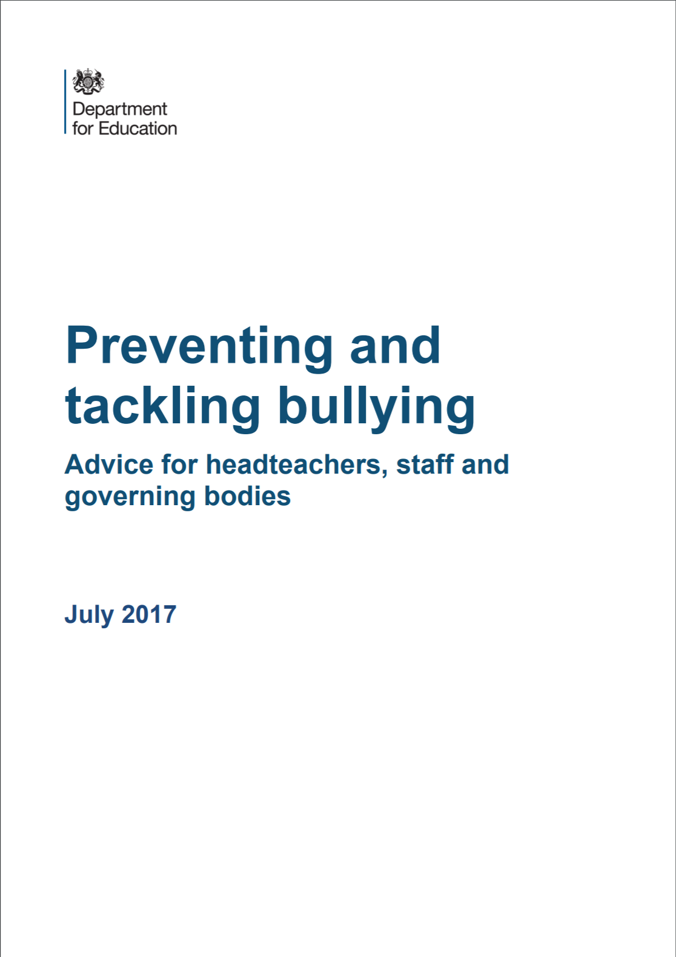
Mental health resources
Notes:
The department has published advice and guidance on Preventing and Tackling Bullying, and Mental Health and Behaviour in Schools. In addition, Public Health England has produced a range of resources to support secondary school teachers to promote positive health, wellbeing and resilience among young people including its guidance Promoting children and young people’s emotional health and wellbeing. See Rise Above for links to all materials and lesson plans (para 38)

Slide 24
Statutory RSE and Health Education

Slide 25
Compulsory curriculum from September 2020
3.6.20 DfE said schools could delay ( due to “competing priorities and Covid 19”)
Delays can be as far ahead as summer 2021 BUT schools are expected to start this at an appropriate point in the 20/21 academic year
Clear links to KCSE 2020 i.e. preventing and tackling bullying, sexual violence, behaviour and discrimination in school , mental health and behaviour and more
Notes:
DSL and team to be aware of the cross referenced school guidance –statutory and otherwise which links in.
Check the start date for this in school
Set up clear lines of communication with teachers, share information re. vulnerable children , those” with a particular protected characteristic ( which means they are at greater risk .”)
Think about whether extra support is needed for the young person, Speak with them
Where a child is in foster care , living in a children’s home make sure that clear lines of communication are in place with foster carers or the Manager of the home.

Slide 26
Compulsory curriculum from September 2020
Clear theme of safeguarding throughout the curriculum document.
Sections 76-82 and 116-122 particularly apply.
“At the heart of these subjects there is a focus on keeping children safe, and schools can play an important role in preventative education”
Notes:
https://www.gov.uk/government/publications/relationships-education-relationships-and-sex-education-rse-and-health-education

Slide 27
Child in Need review and update to links with DSL role

Slide 28
Children who are potentially at greater risk of harm
This still includes LAC/previous LAC, care leavers and SEND but now also includes ‘children who need a social worker’. Designated safeguarding leads should:
Promoting educational outcomes of children in need of help or protection
Share information about welfare, safeguarding and CP issues with teachers and leaders
Have a particular focus on children with social workers
DSLs could:
Ensure staff know who these children are
Understand these students’ academic progress & attainment
Maintain a culture of high aspirations for this cohort
Support teaching staff to identify challenges they may face and the academic support and adjustments that could be made
Review the role of the DSL in line with addition to Annex B of KCSE to ensure that DSLs can support staff to know which children have Social Work support
Notes:
Children who are potentially at greater risk of harm-Children in Need

Slide 29
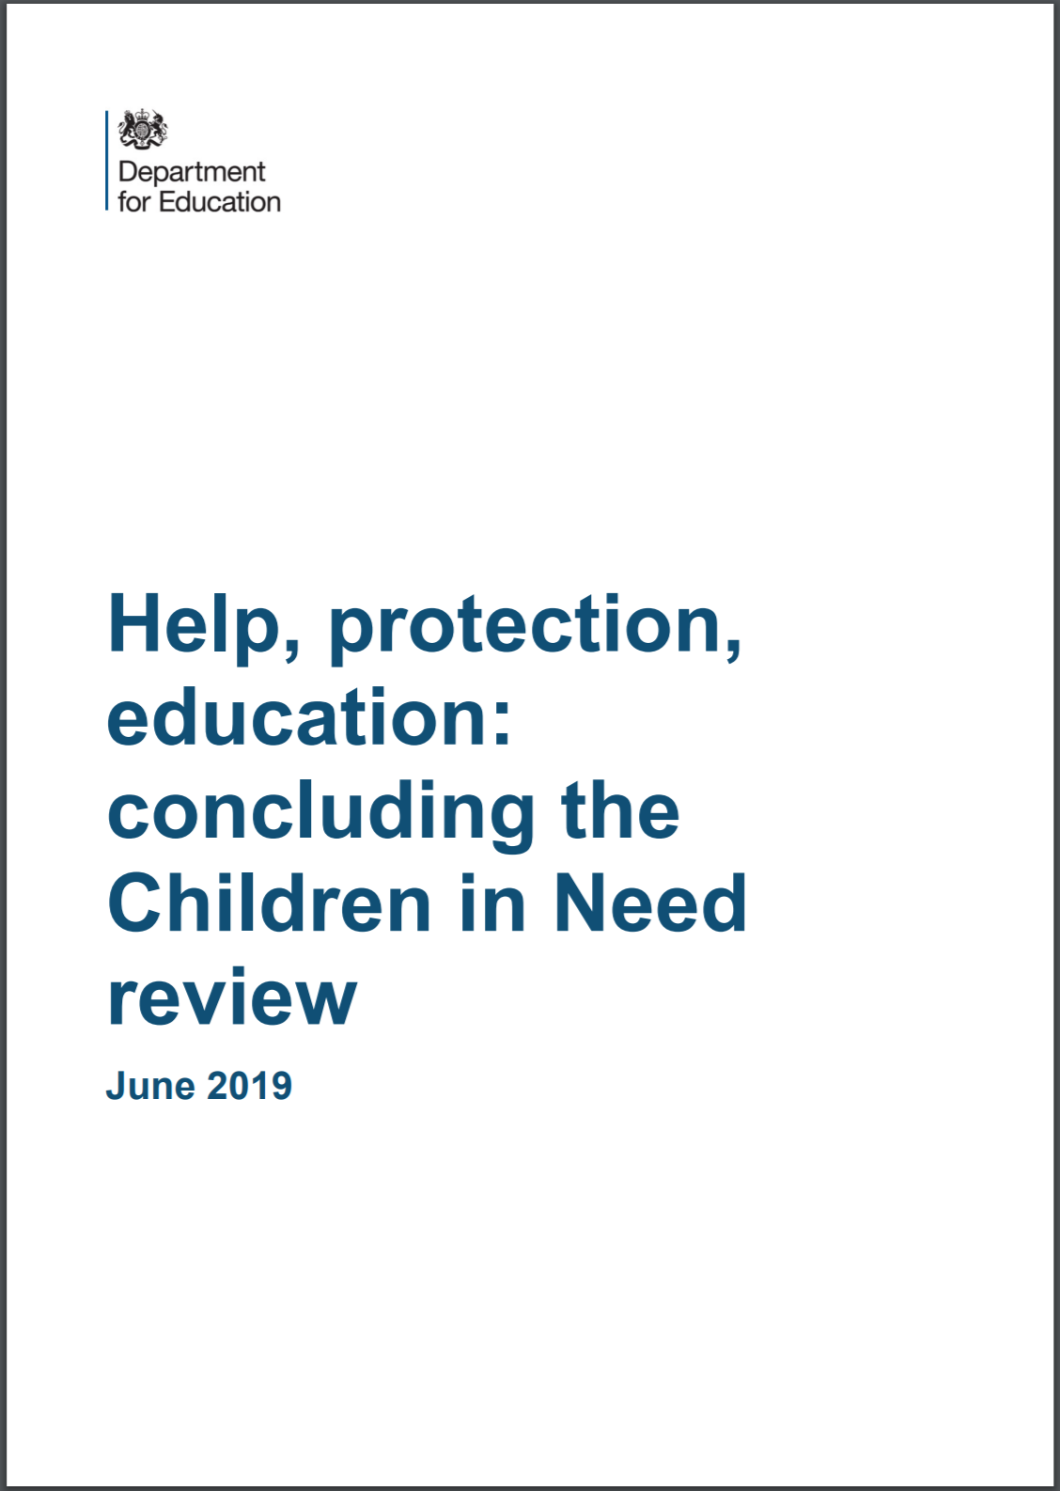
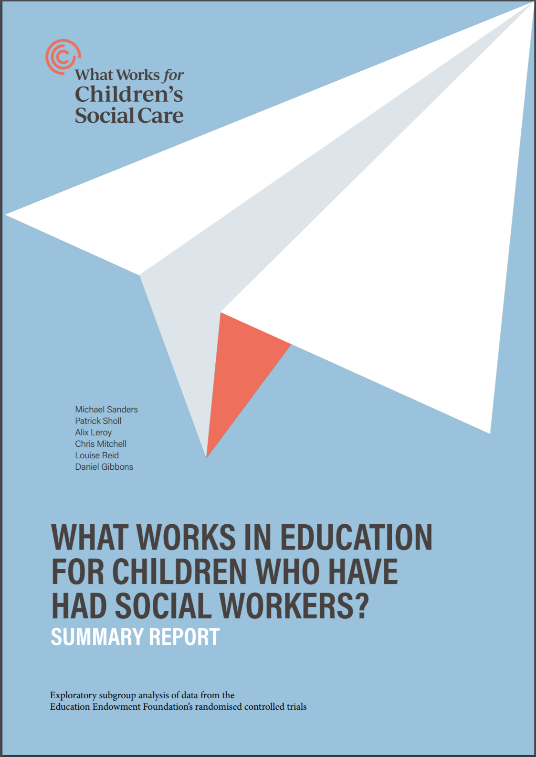
Background & implications
Recognition children with social workers may continue to be vulnerable and be educationally disadvantaged in attendance, learning, behaviour and mental health
Local authorities to routinely share the fact a child has a social worker. DSL to hold and use this information.
This information should also inform the response to further safeguarding concerns (e.g. absence, missing) and support

Slide 30
Other updates

Slide 31
When to call the police
Covers criminal activity, not safeguarding
Assault
Criminal damage
Cyber crime
Drugs
Harassment
Sexual offences
Theft
Weapons
Is this an internal matter?
When to cease ‘investigating’?
When to call the police?
Notes:
This advice does not cover safeguarding incidents. Where a child is suffering, or is likely to suffer from harm, it is important that a referral to children’s social care (and if appropriate the police) is made immediately. Referrals should follow the local referral process.
Contact with police should ideally be made by a single point of contact from the school. This may be the headteacher or the designated safeguarding lead to ensure all the relevant information is shared and improve consistency of referrals
When an incident occurs in which a crime has or may have been committed, the school or college need to consider whether to involve the police. Many incidents can be dealt with and resolved internally. The school or college behaviour policy will give guidance on how to deal with and record such incidents. In making a decision to involve the police it is important that the school or college ensure a balance is struck between the needs of the students involved and the needs of other students and the wider school or college community. The victim in any incident should be supported and protected as a priority. Those suspected of being the offender will also need to be supported. There will often be significant circumstances in a young person’s life that are contributing factors to an incident and it is important that they are taken into consideration. The seriousness of the incident will be a judgement call for the school or college. In making this decision the level of harm and the circumstances leading to the incident would need to be carefully considered.
When the decision is made to report an incident to the police for investigation, due to the seriousness of the incident or for other aggravating circumstances, the school or college should cease their own investigation, having asked only enough questions to establish the basic facts of the incident. Every effort should be made by the school or college to preserve any relevant evidence.

Slide 32
When to call the police
Other factors to consider
Vulnerabilities of pupils involved
Aggravating factors
Support for all including alleged ‘offender’
External factors
Parental involvement
Evidence, weapons, drugs etc.
Notes:
The school or college should be aware that they may not be aware of all circumstances leading to or connected to the incident i.e. students behaviour or involvement outside school or within their family. Contacting the police or other agencies may allow a further picture to be obtained, which assists in making informed decisions.
Parental cooperation should be maintained throughout and the incident and actions recorded

Slide 33
When to call the police
Other useful documents

Slide 34
Peer on peer / child on child
May not just be between peers
Previous forms peer on peer abuse included:
Physical abuse
Sexual violence and sexual harassment
Sexting and
Initiation/hazing type violence and rituals
Definition now widened to include
Bullying (including cyberbullying) and
Upskirting
abuse within intimate partner relationships
https://safeguarding.network/safeguarding-resources

Slide 35
So-called ‘honour-based’ abuse
Shift from so-called ‘honour-based’ violence to include incidents or crimes committed to protect or defend the honour of the family and/or the community
Incorporates FGM, forced marriage, breast ironing and similar
Wider definition than the previous violence based model similar to the shift in perception of domestic abuse rather than just domestic violence
Notes:
Abuse committed in the context of preserving “honour” often involves a wider network of family or community pressure and can include multiple perpetrators. It is important to be aware of this dynamic and additional risk factors when deciding what form of safeguarding action to take.
‘Similar’ forms e.g. acid attacks, pressure to move abroad, murder.

Slide 36
Domestic abuse
“All children can witness and be adversely affected by domestic abuse in the context of their home life where domestic abuse occurs between family members.
Exposure to domestic abuse and/or violence can have a serious, long lasting emotional and psychological impact on children.
In some cases, a child may blame themselves for the abuse or may have had to leave the family home as a result”
Notes:
Definition of the impact on children has been slightly shortened and improved, although no major changes.
Page 85

Slide 37
Domestic abuse resources
Operation Encompass is now described in Annex A. All school staff should know what this is and schools should have a clear process for managing these ‘notifications’. Also mentioned are:
Notes:
Definition of the impact on children has been slightly shortened and improved, although no major changes.
Page 85
Annex A includes reference to supportive services
KCSE says referrals. This has been amended here to notifications as they are not a ‘referral’ to anything.
Also mentioned are organisations who can help where children are affected by DA.

Slide 38
Radicalisation – added/revised definitions
Channel is a voluntary, confidential support programme which focuses on providing support at an early stage to people who are identified as being vulnerable to being drawn into terrorism. Prevent referrals may be passed to a multi-agency Channel panel, which will discuss the individual referred to determine whether they are vulnerable to being drawn into terrorism and consider the appropriate support required.
Terrorism is an action that endangers or causes serious violence to a person/people; causes serious damage to property; or seriously interferes or disrupts an electronic system. The use or threat must be designed to influence the government or to intimidate the public and is made for the purpose of advancing a political, religious or ideological cause.”
Notes:
The governmental definition of terrorism has been added to KCSiE (p89)
Channel definition (with emphasis on voluntary nature) has been amended with a link to the guidance for channel and prevent (p90). A representative from the school or college may be asked to attend the Channel panel to help with this assessment. An individual’s engagement with the programme is entirely voluntary at all stages.
The school’s DSL or deputy should be aware of local procedures for making a prevent referral

Slide 39
What to do next?

Slide 40
DSLs/DDSLs have received the following…
Keeping Children Safe in Schools 2020 draft document with ‘tracked’ changes.
‘Changes’ document with clear description of changes from 2019 to 2020 version and actions to take.
Updated Child Protection policy for Sept 2020 with ‘changes’ document.
Guidance for Safer Working Practices with Covid 2020 addendum
Notes:
DSLs will also be able to attend a briefing in the next few weeks with a similar presentation.

Slide 41
Action plan
Follow actions from ‘changes document’ provided from LW to schools.
All to read Part 1 and Annex A of Keeping Children Safe in Education 2020.
Brief staff on main updates
Safeguarding links to Mental Health
The need to consider CIN cohorts and their specific needs
Relationships Education/Relationships & Sex Education/Health Education
child exploitation, peer on peer/child on child, so-called ‘honour-based’ abuse, domestic abuse, radicalisation
Develop the role of the DSL linked to changes above.
Update Child Protection policy.
Ensure new information is added to other relevant polices e.g. allegation management policy, RSE policy
Be aware that Keeping Children Safe in Schools 2020 changes have been added to whole school training
Notes:
Staff to be fully aware of the implications of the new compulsory RE,RSE,HE curriculum and clear alignment with safeguarding
Draft version March 2020 outlined some crucial points in the role of the DSL adding in ‘additional’ time and ‘appropriate supervision’ support
Sept 2019 and 2020: ‘They should be given the time, funding, training, resources and support’
March 2020: ‘They should be given ‘additional’ time, funding, training, resources and ‘appropriate supervision’ support.
Therefore its likely in the next version of KCSE that dedicated time and safeguarding supervision will become an expectation to support the DSL role in schools

Slide 42
Other safeguarding e-learning
Introduction to the Prevent Duty
Female Genital Mutilation
Awareness of Forced Marriage
Understanding Animal Welfare in Violent Homes
Parental Substance abuse
Adverse Childhood Experiences (ACEs)

Slide 43
Thank you Any questions?

