Slide 1
2020
Early Help
Who’s Who

Slide 2
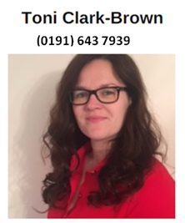
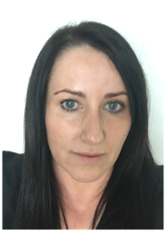
Senior Manager for Prevention & Early Help Lesley is a member of the Senior Management Team in Children’s Services and has overall responsibility for Prevention and Early Help including Children’s Centres, Locality Teams, and the delivery of the Public Health priorities for children and young people 0-19, as well as the Troubled Families work. Senior Manager Professional Nursing Lead 0-19 Children's Public Health Service Jo is part of the public health team and has responsibility for the management of the 0-19 Children’s Public Health Service. She provides professional leadership for the service and ensures that the Healthy Child Programme 0-19 is delivered across North Tyneside to children, young people and their families by locality based skill mix teams, including health visitors and school nurses. Early Help MASH Manager Toni sits at the Front Door and is part of the MASH. Toni reviews cases as they come in for their suitability for Early Help. She also manages the Early Help Coordinators and the Care and Connect staff Early Help MASH Manager Joanne has been covering Toni’s maternity leave, however she will continue to offer support for the time being
Lesley Davies (0191) 643 6462
Jo Connolly (0191) 643 2110
Toni Clark-Brown (0191) 643 7939
Joanne Telford (0191) 643 7939

Slide 3
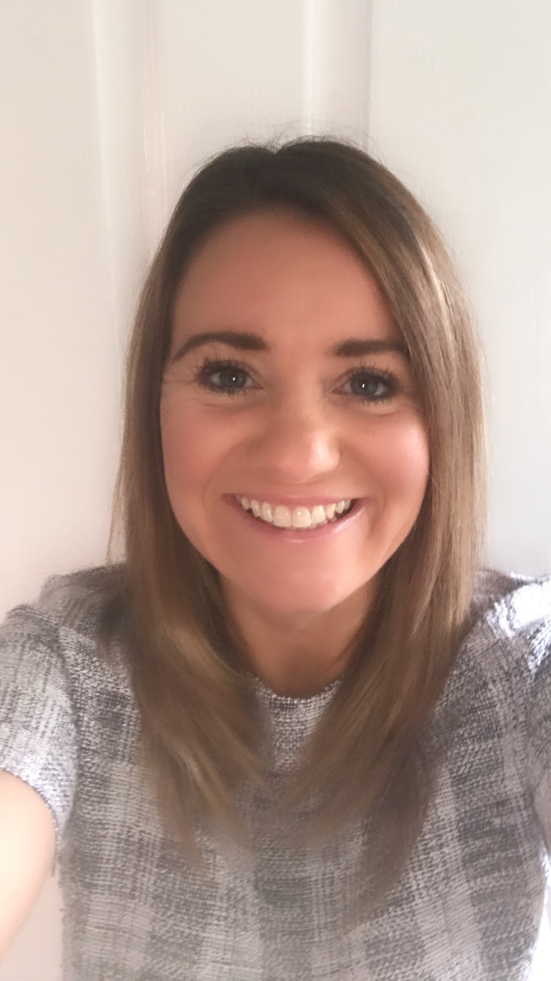
Locality Manager - North West & Coast Bev manages the Shiremoor Children’s Centre, as well as the North West /Coast Locality teams who are based in Shiremoor Children’s Centre and Whitley Bay Customer First Centre Bev will be covering the Central Locality whilst Julie Connolly is helping out with another project Acting Locality Manager – South West & Central Christine McMillan will be covering the SW Locality as Julie Connolly is helping out with another project. Early Years Manager – Early Help and Prevention Nicki is based at Riverside Children’s Centre, and is responsible for overseeing the Ready for School setting, which works with families entitled to 2 year funding and supporting partners who work with vulnerable families.
Bev Marrs
(0191) 643 8293
Christine McMillan
(0191) 643 6262
Nicki Garner
(0191) 643 8266

